Slide 1

MATH24 Differential Equations

Slide 2
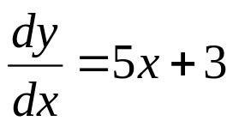
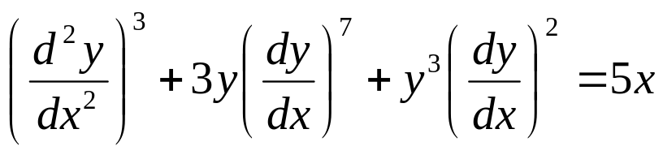
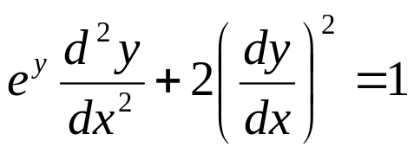
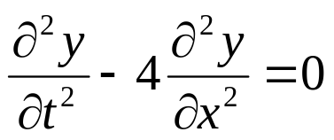
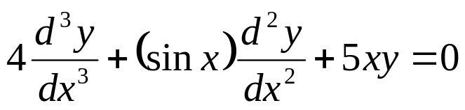
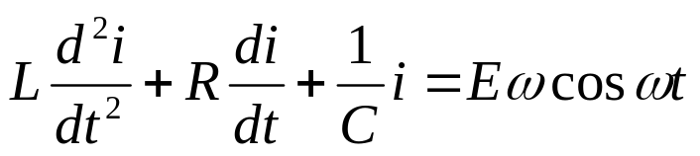

Definitions
An differential equation is an equation involving an unknown function and its derivatives.
The following are differential equations involving the unknown function y.
(1.1)
(1.4)
(1.2)
(1.5)
(1.3)
(1.6)
(1.7)

Slide 3
Definitions
A differential equation is an ordinary differential equation (ODE) if the unknown function depends on only one independent variable. If the unknown function depends on two or more independent variables, the differential equation is a partial differential equation (PDE).
Equations (1.1) through (1.4) are examples of ordinary differential equations, since the unknown function y depends solely on the variable x. Equation (1.5) is a partial differential equation, since y depends on both the independent variables t and x.

Slide 4
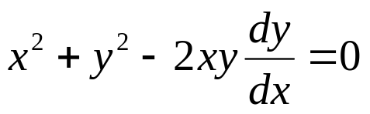
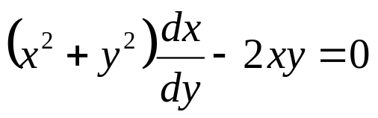
Definitions
In equation 1.6
i is the dependent variable, t the independent variable, and L, R, C, E, and ω are called parameters.
Since the equation 1.7
may be written as
or
we may consider either variable to be dependent, the other being the independent one.
,

Slide 5
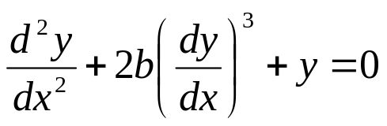


Definitions
The order of a differential equation is the order of the highest-ordered derivative appearing in the equation. For instance,
is an equation of “order two”. It is also referred to as a “second-order” equation.”
More generally, the equation
Is called an “nth-order” ordinary differential equation. Under suitable restrictions on the function F, equation (1.9) can be solved explicitly for y(n) in terms of the other n + 1 variables x, y, y′, . . . , y(n − 1), to obtain
(1.8)
(1.9)
.
(1.10)c

Slide 6

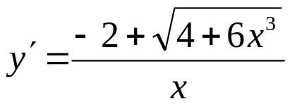
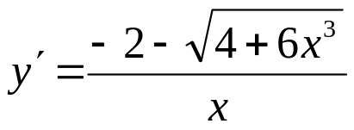
Definitions
For example, the equation
actually represents two different equations,
or
.

Slide 7
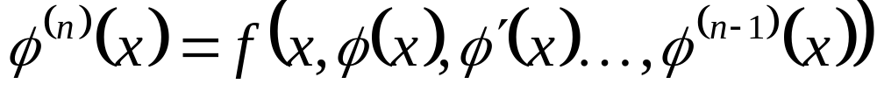
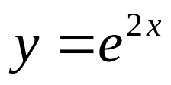
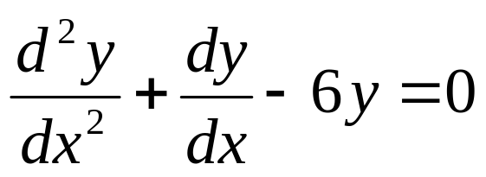
Definitions
A function ϕ, defined on an interval a < x < b, is called a solution of the differential equation (1.10), provided that the n derivatives of the function exist on the interval a < x < b and
for every x in a < x < b.
Example: Verify that
is a solution of the equation
,
.
(1.11)

Slide 8
Definitions
The solution of a differential equation is a non-derivative relation between the variables which satisfies the given differential equation. It can be a General/Primitive Solution, Particular Solution or Singular Solution.

Slide 9



Definitions
General Solution or Primitive Solution
The general or primitive solution of a differential equation is a solution which contains arbitrary constant/s which is/are usually represented by letters. Geometrically, this represents a family of curves.
Exercises:
Determine which of the following equations is a general solution or primitive.

Slide 10


Definitions
Particular Solution
The particular solution is obtained from the general solution by determining the value of the arbitrary constant and substituting it in the general solution.
Exercises:
Determine which of the following equations is a particular solution.

Slide 11
Definitions
Singular Solution
A solution free of arbitrary constants, and is not obtained from the general solution, is called a singular solution.
Exercise:
Show that the differential equation (4x³ − y³)dx + (2y − 3xy²)dy = 0 has x⁴ − xy³ + y² = c as its solution where c is a constant.

Slide 12
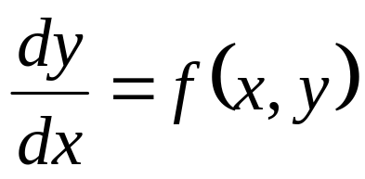
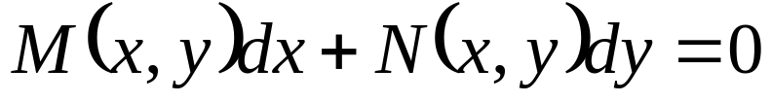
Definitions
Equations of order one may be written as
It is sometimes convenient to use the definitions of elementary calculus to write the equation in the form
.
(1.12)

Slide 13
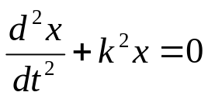
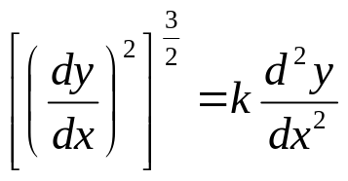
Definitions
Degree of the Differential Equation
The degree of the differential equation is the same as the exponent of the highest-ordered derivative in the given equation after the equation has been rationalized or cleared of fractions with respect to all the derivatives.
Exercises:
Find the degree of the following differential equations.

Slide 14
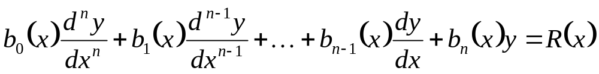
Definitions
A very important concept in the study of differential equations is that of linearity. An ordinary differential equation of order n is called linear if it may be written in the form
Examples:
(1.8)
is nonlinear.
(1.11)
is linear.

Slide 15

Definitions
The equation
is also linear.

Slide 16
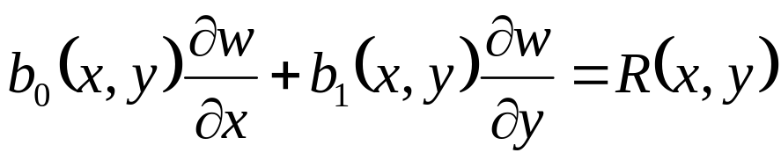
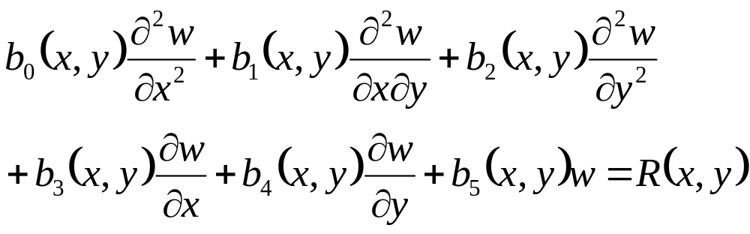
Definitions
The notion of linearity may be extended to partial differential equation with two independent variables. For example, the equation
is the general first-order linear partial differential equation with two independent variables, and
is the general second-order linear partial differential equation with two independent variables.

Slide 17
Summary
Classifications of Differential Equations
According to Properties: Order and Degree
According to Type: Ordinary and Partial DE
According to Kind: Linear and Nonlinear
Types of Solution
General Solution or Primitive Solution
Particular Solution
Singular Solution

